Slide 1

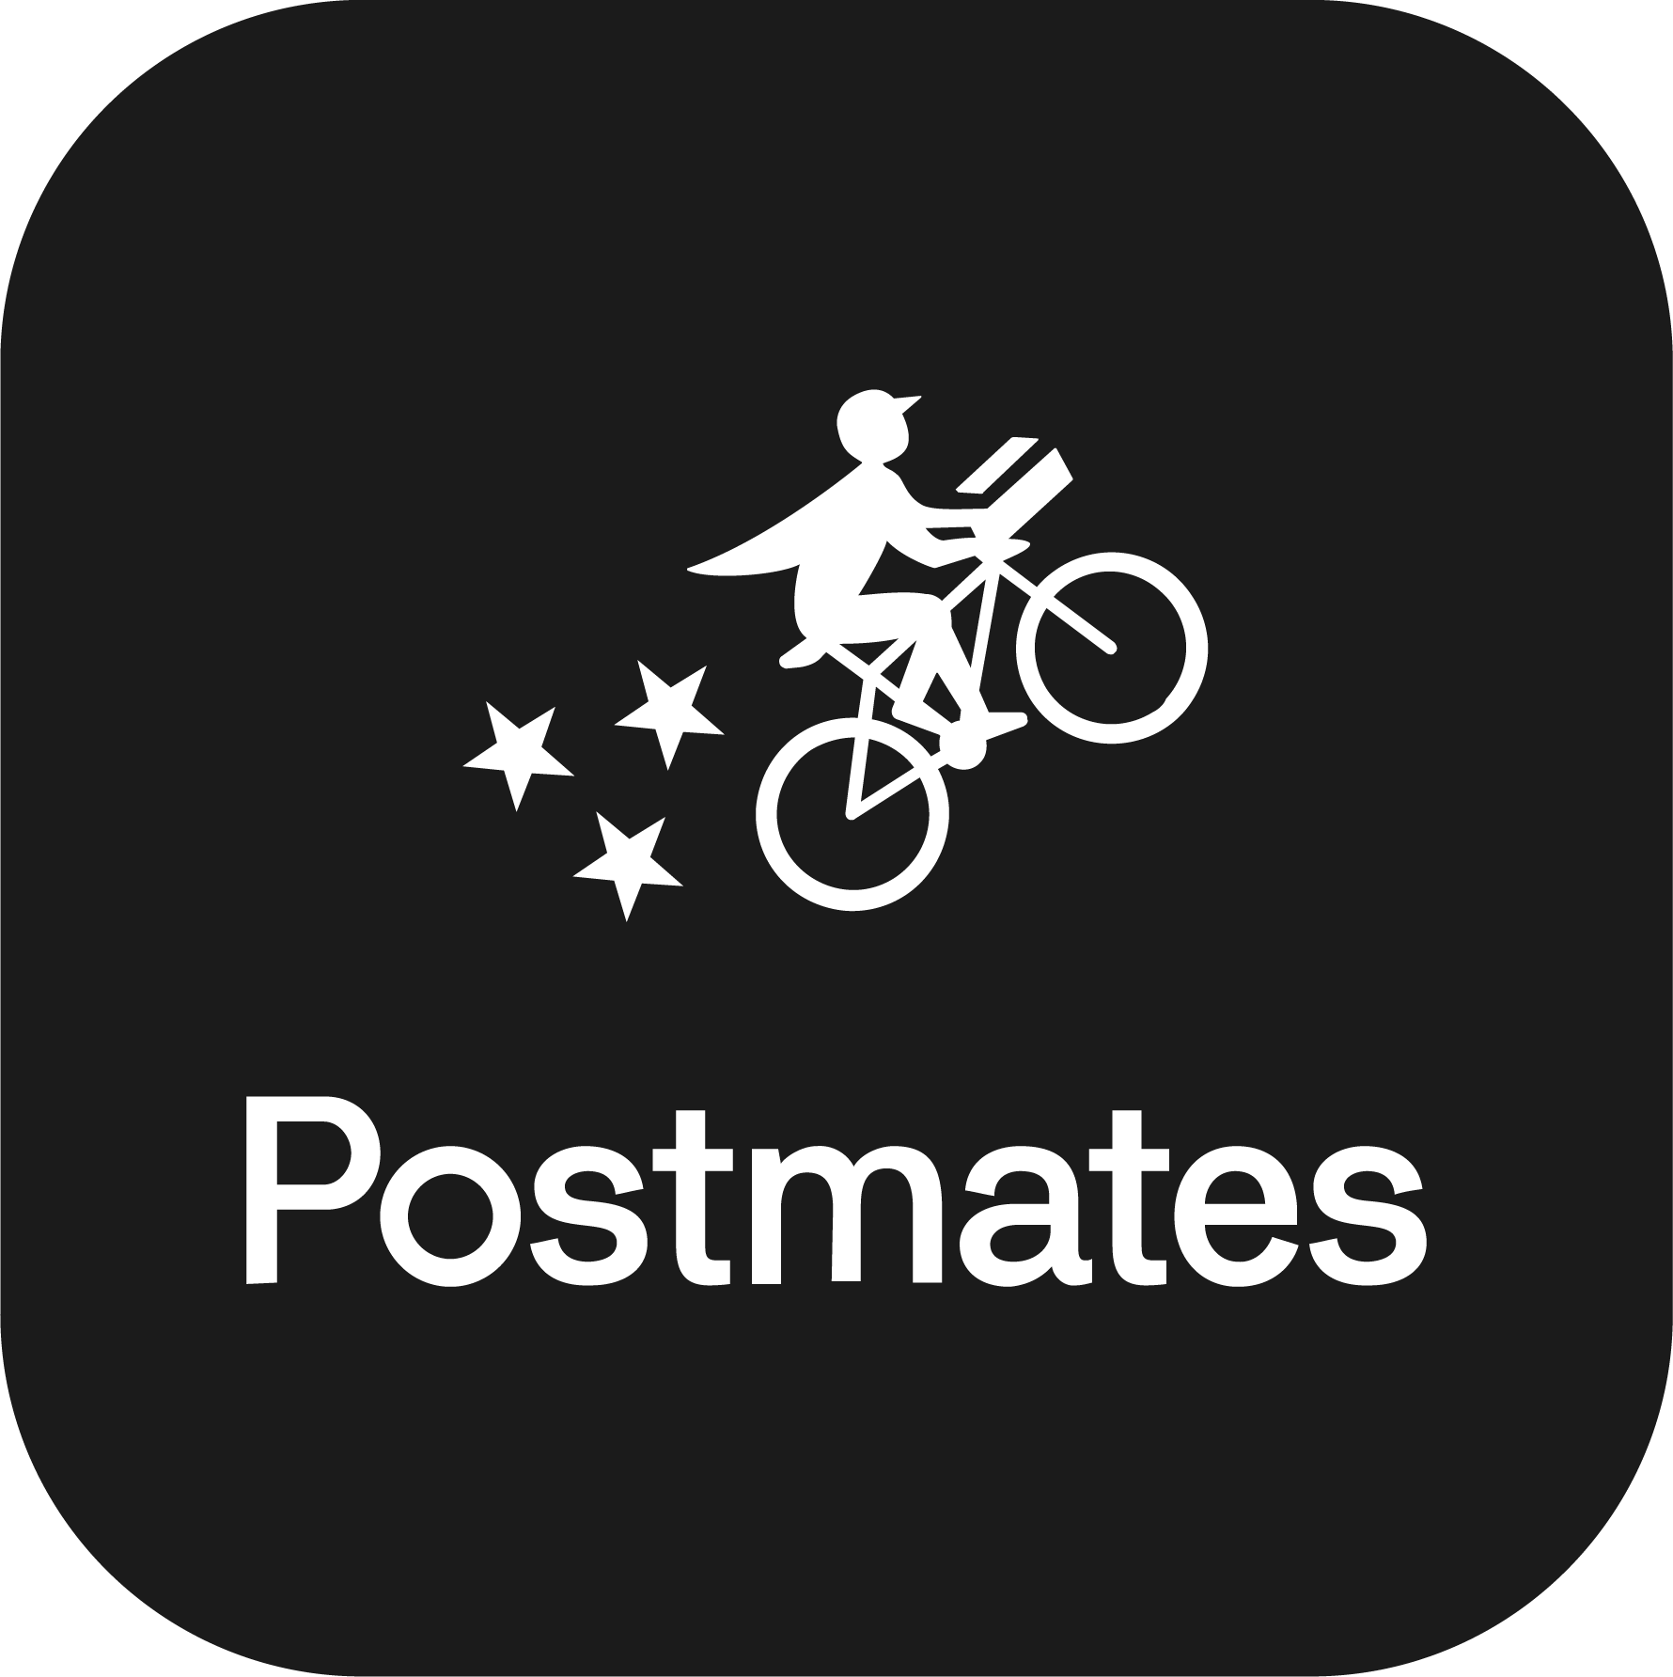


Food Delivery Intermediaries
Group 1: Haokai Gou, Harsh Wardhan, Jeet Patel, Kirsten Hugh, Sarah Alikhan, Scarlet Wessin, Snehal Jitendra Deshmukh

Slide 2
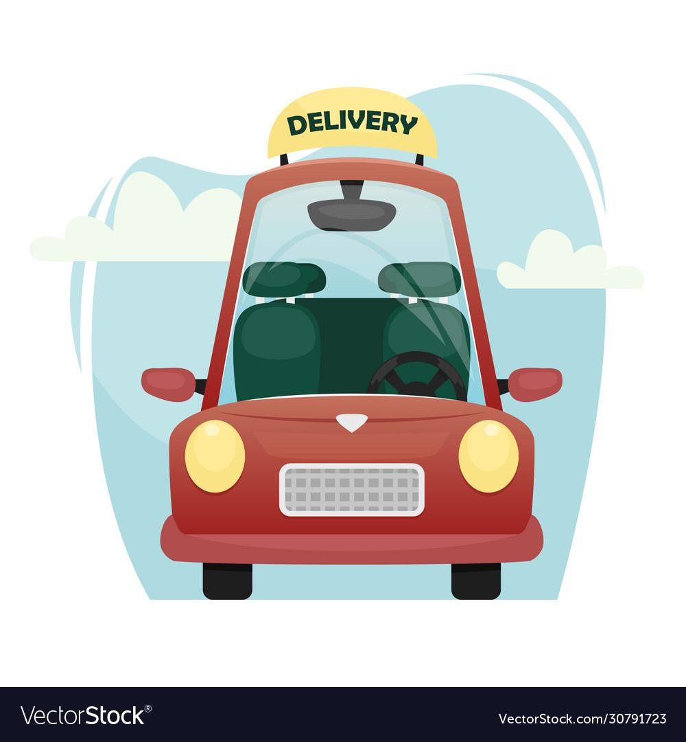
1
Background Information
2
ER Diagram
3
Logical Schema - 3NF
4
MySQL Workbench
5
Example Queries

Slide 3
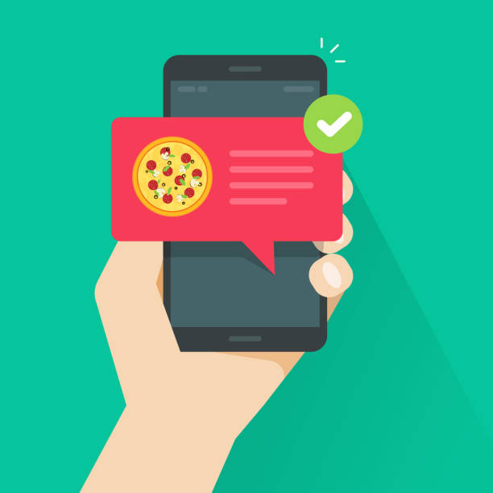
Background Information
Business Application
Model
Operation

Slide 4
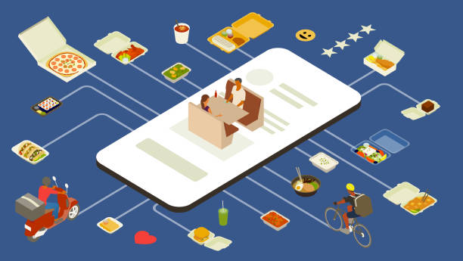
Food Delivery: Business Application
Food delivery - an indispensable aspect of modern-day living.
Approx. ⅓ of American Population orders food delivery no less than twice per week (Hendelmann, 2023).
By 2024, global food delivery market will be valued at $182.3 billion (Spdload, 2023).
Used by Restaurants, Grocery Stores, Meal Kit Services, Catering Companies, Food Trucks.

Slide 5
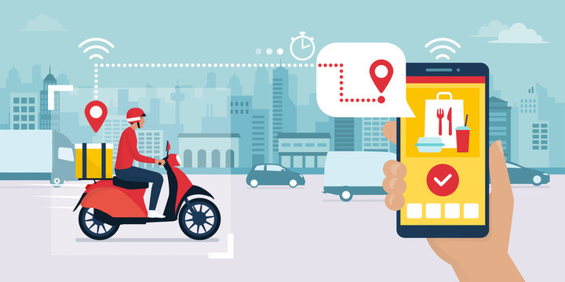
What food item do you think was delivered in the earliest documented case of food delivery?

Slide 6

What food item do you think was delivered in the earliest documented case of food delivery?
Yes, it was pizza.
The earliest documented case of food delivery happened in Italy in 1889 when Raffaele Esposito, the inventor of Pizza Margherita, was summoned by King Umberto and Queen Margherita to deliver a pizza to their palace in Naples (history of food delivery 2021).

Slide 7
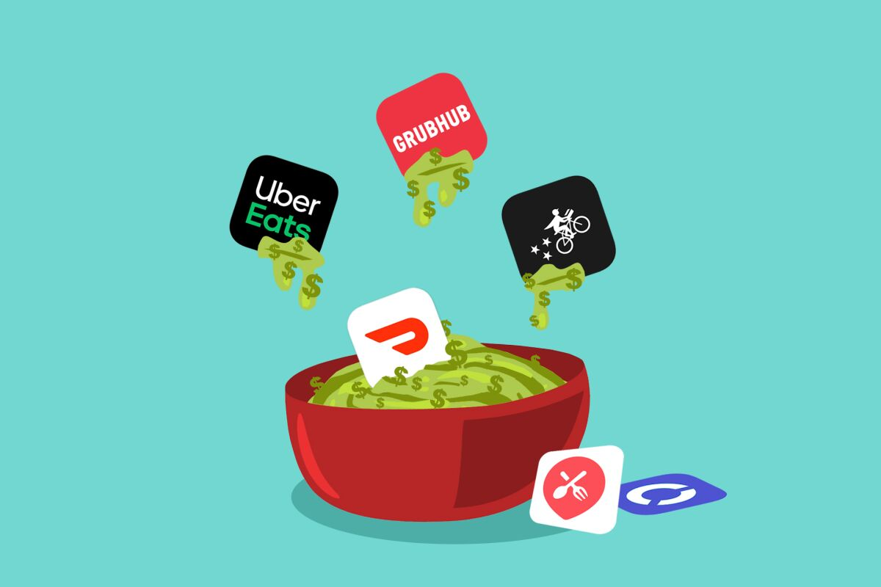
Food Delivery: Business Application
Food delivery: type of courier service where meals or food items are transported from stores, restaurants, or third-party applications to customers who have placed orders and require delivery on an immediate or scheduled basis (Hendelmann, 2023).
It has risen and expanded globally due to:
Technological advancements
Changing consumer habits
Need for convenience and accessibility

Slide 8

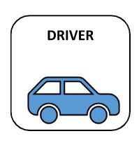
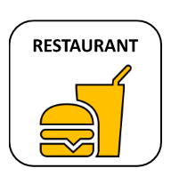
Food Delivery: Model
Customer Ordering
Delivery Agent
Restaurant

Slide 9
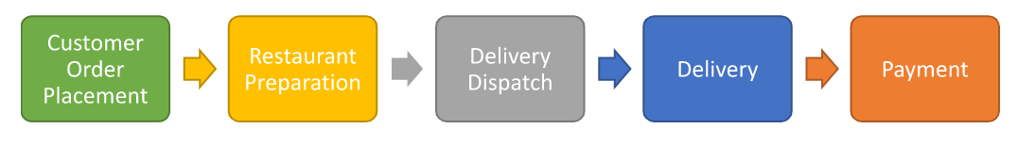
Food Delivery: Operation
Customers select restaurant, menu items, and delivery address on the app or website. On the checkout page, they review details, set tip/payment, delivery time, and apply promotions.
Upon confirmation of payment, the restaurant receives the order and prepares the food, packaging it for delivery.
The delivery service dispatches an available driver to pick up the food from the restaurant and deliver it to the customer.
The driver follows the optimized route provided by the delivery service's dispatch system to deliver the food to the customer.
Customers pay for their order on the app/website, which is verified before the service pays the restaurant and driver.

Slide 10
Entity Relationship Diagram
ER Diagram of Food Delivery System

Slide 11
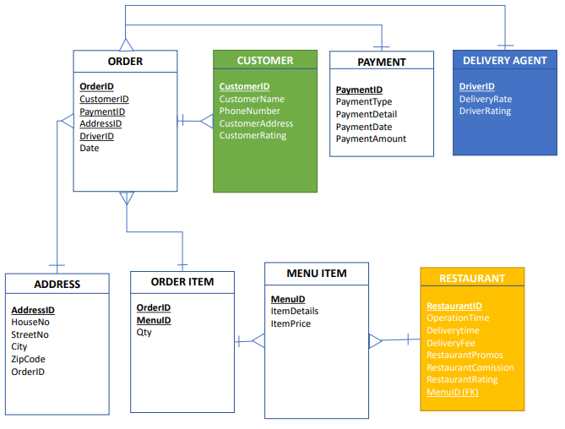
Food Delivery: ER Diagram

Slide 12
Logical Schema 3rd Normal Form
ER Diagram to Logical Schema

Slide 13
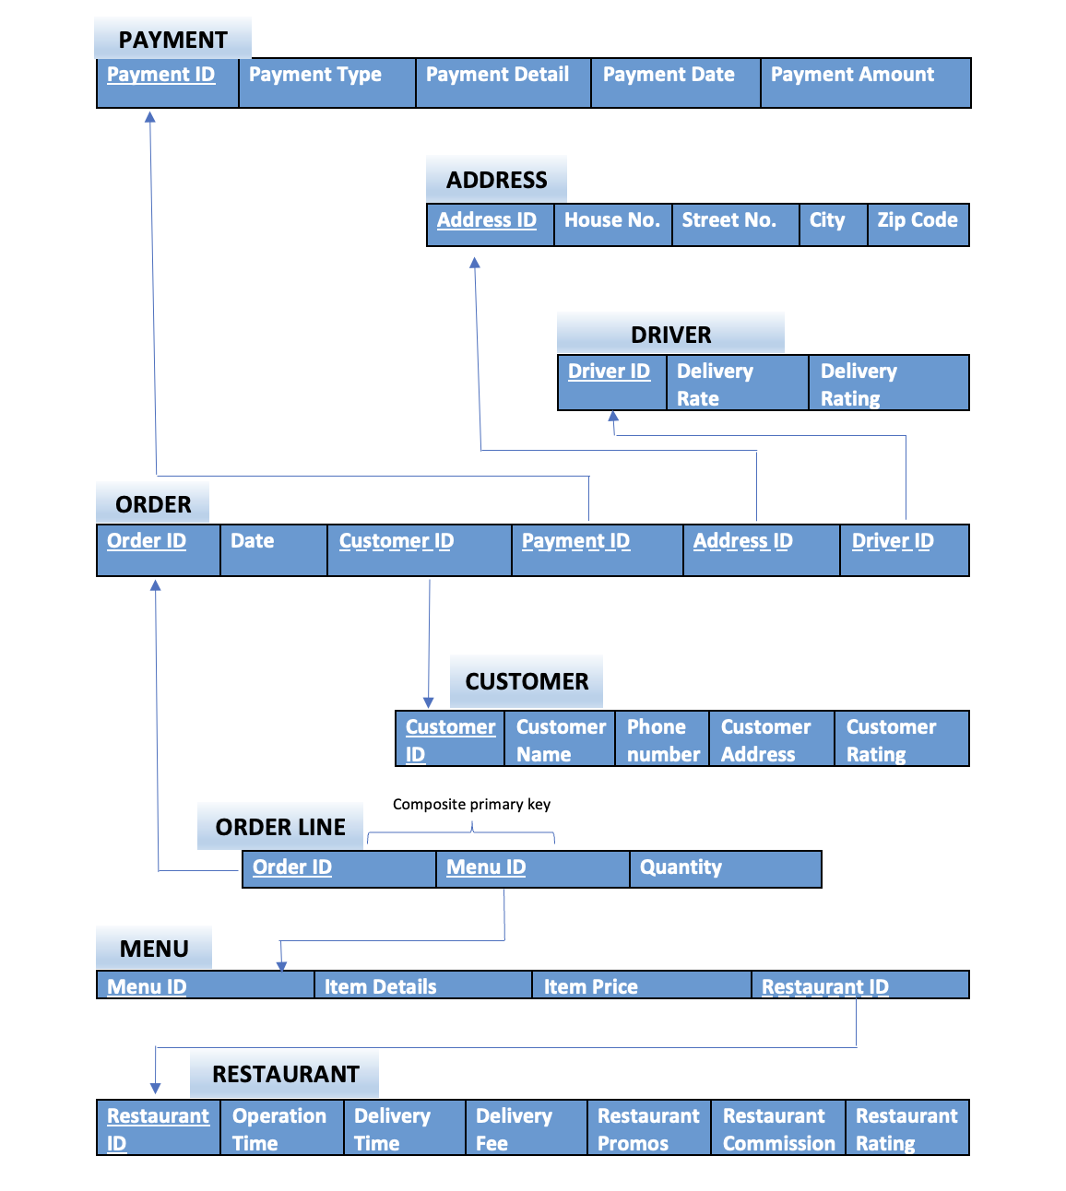
Food Delivery:
Logical Schema

Slide 14

MySQL Workbench
Creating the Database
Modifying the Database

Slide 15
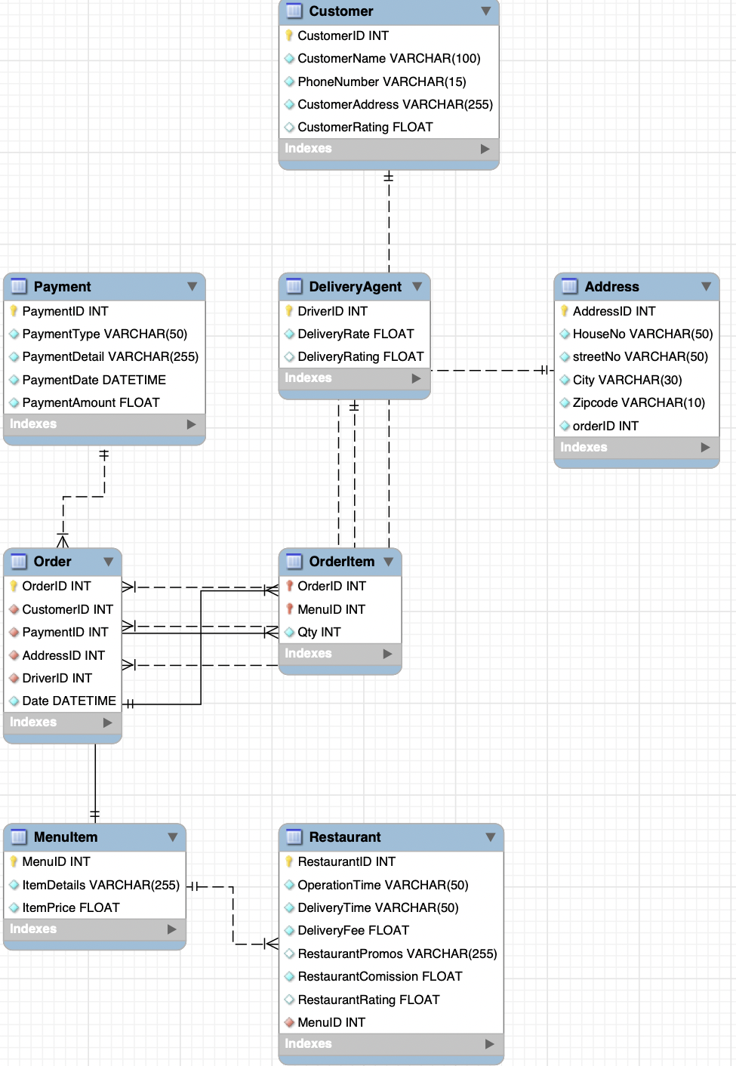
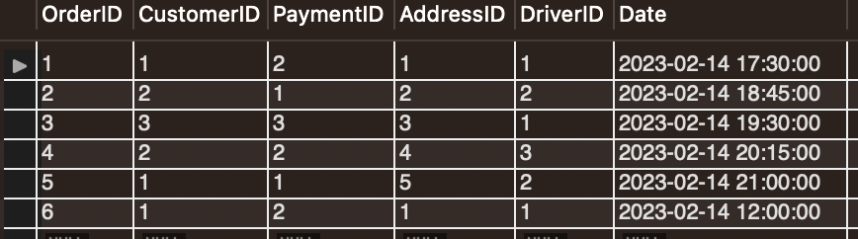
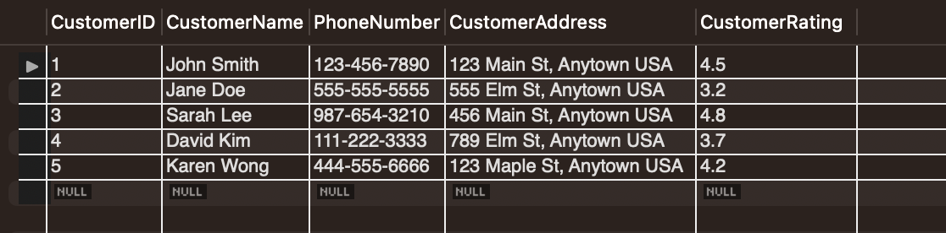
Food Delivery: Creating the Database

Slide 16
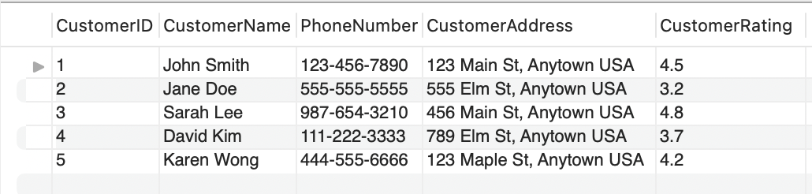
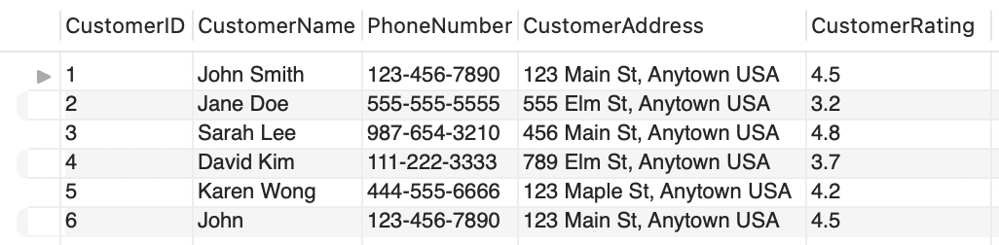
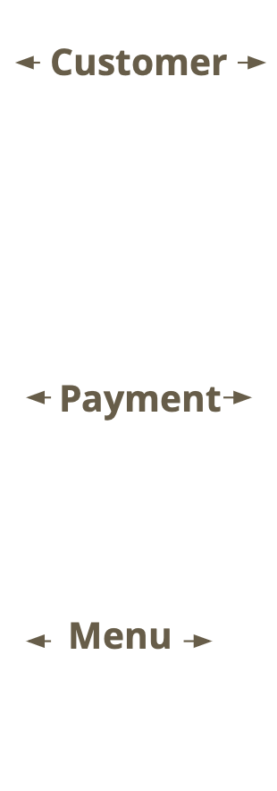
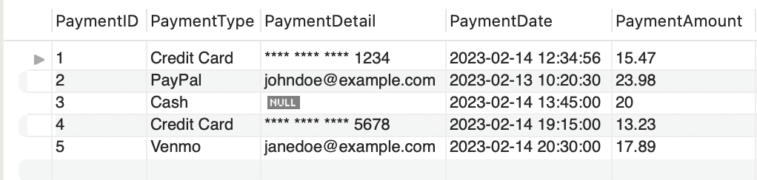
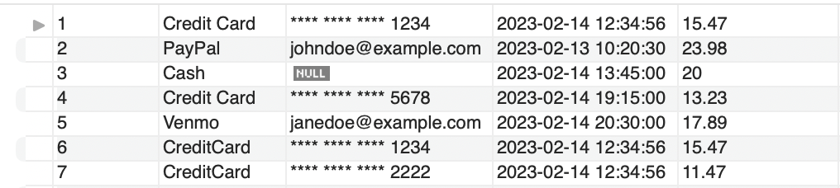
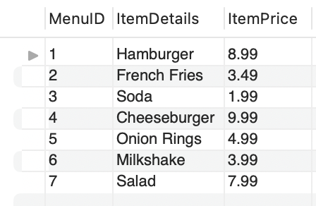
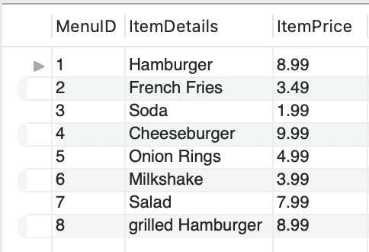
INSERT
Before After
I
Notes:
JEET

Slide 17
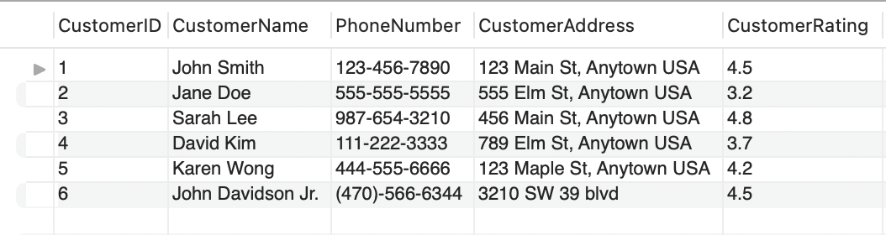
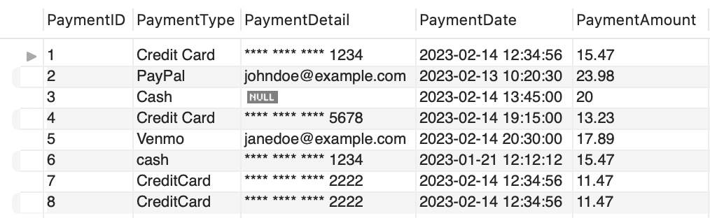
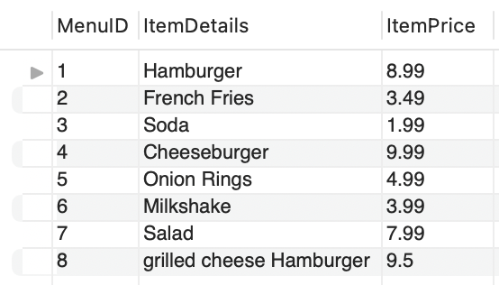
UPDATE
Before After
Notes:
JEET

Slide 18
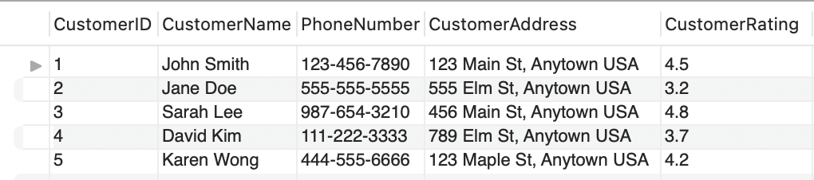
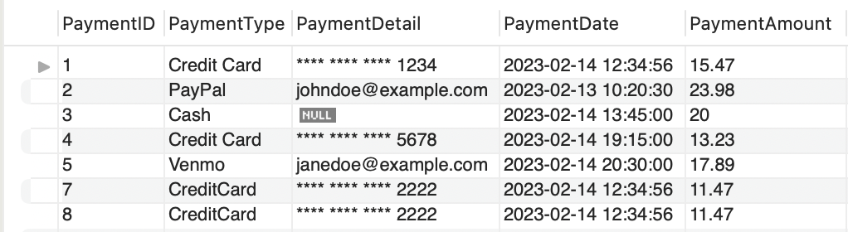
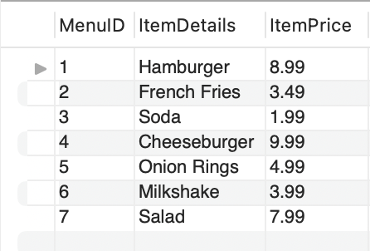
DELETE
Before After
Customer
Payment
Menu
Notes:
JEET

Slide 19
Example SQL Queries
Three Examples with Real-World Applications

Slide 20

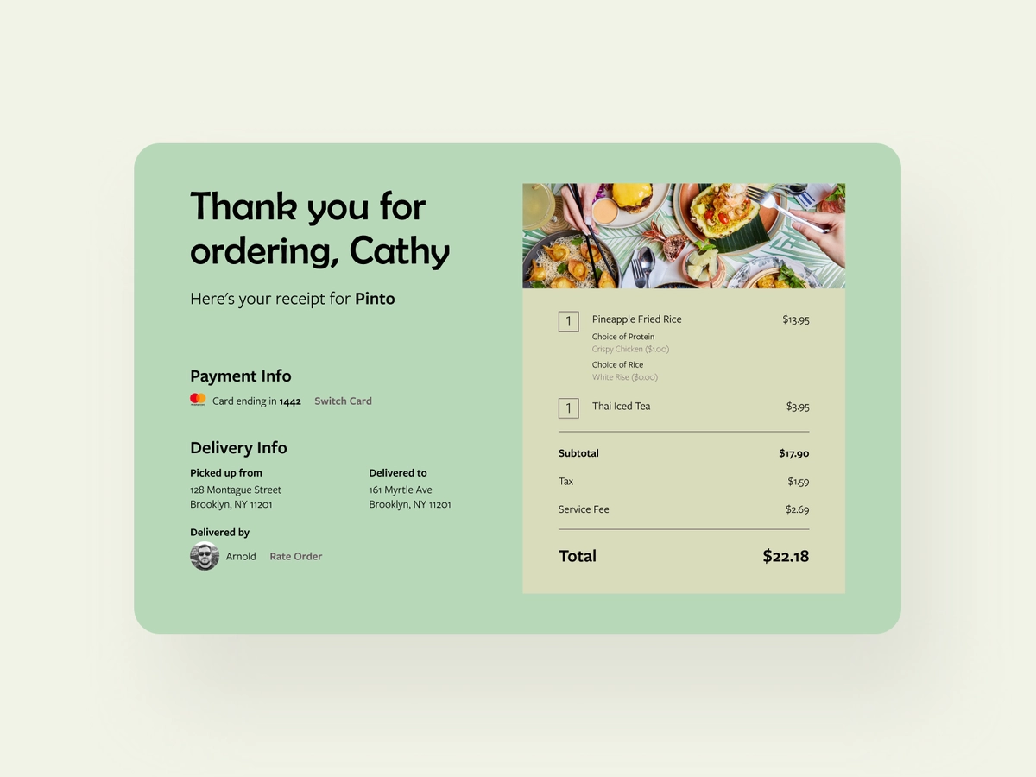
Example Query 1: Order Receipt
An Order Receipt can include:
Customer
Restaurant
Order Date & Time
Food Items & Quantity
Payment Information & Total
Delivery Address
Delivery Driver
Food Delivery Service Receipt Mockup
Our Query:
Notes:
SELECT OrderItem.OrderID, OrderTable.Date, RestaurantName, CustomerName, CustomerAddress, PaymentType, PaymentAmount, Qty, ItemDetails, ItemPrice, DeliveryFee
FROM OrderTable, Customer, Payment, OrderItem, MenuItem, Restaurant
WHERE OrderTable.CustomerId = Customer.CustomerID
AND OrderTable.PaymentID = Payment.PaymentID
AND OrderTable.OrderID = OrderItem.OrderID
AND OrderItem.MenuID = MenuItem.MenuID
AND OrderItem.MenuID = Restaurant.MenuID
AND OrderItem.OrderID = 1;

Slide 21
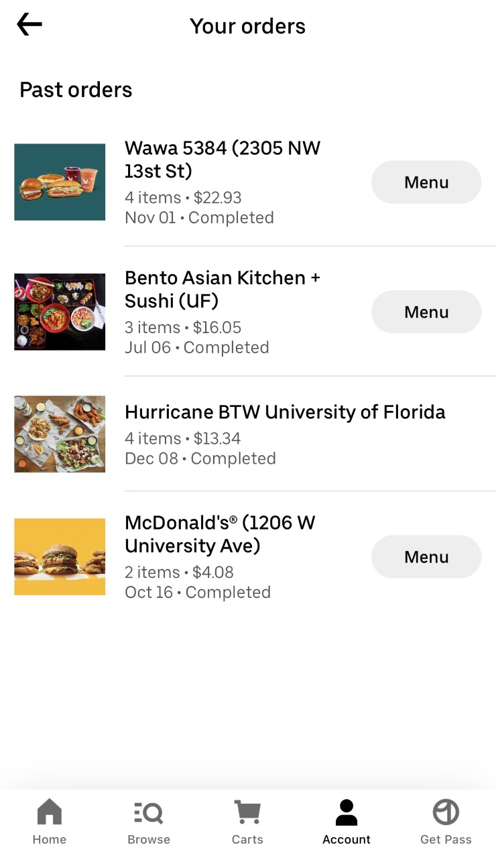
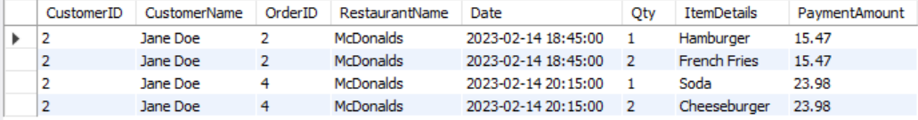
Example Query 2: Customer Order History
Order History can include:
All past orders made by one customer
Restaurant Names
Quantity of Items Ordered
Order Dates
Our Query:
Notes:
SELECT OrderTable.CustomerID, CustomerName, OrderTable.OrderID, RestaurantName, OrderTable.Date, Qty, ItemDetails, PaymentAmount
FROM OrderTable, Customer, OrderItem, Restaurant, MenuItem, Payment
WHERE OrderTable.OrderID = OrderItem.OrderID
AND OrderTable.CustomerID = Customer.CustomerID
AND OrderItem.MenuID = Restaurant.MenuID
AND OrderItem.MenuID = MenuItem.MenuID
AND OrderTable.PaymentID = Payment.PaymentID
AND OrderTable.CustomerID = 2;

Slide 22
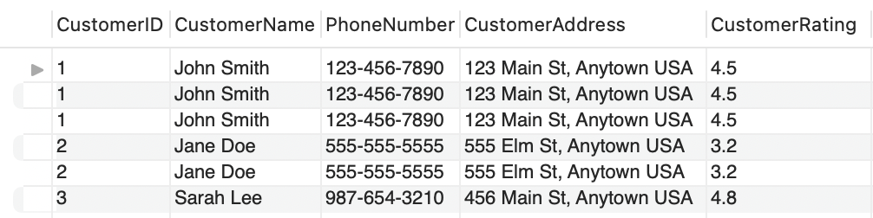
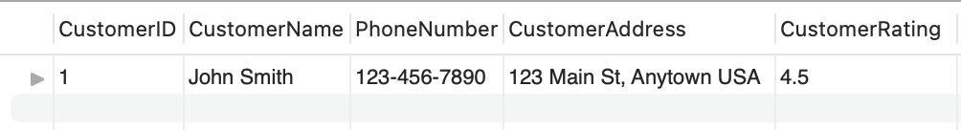
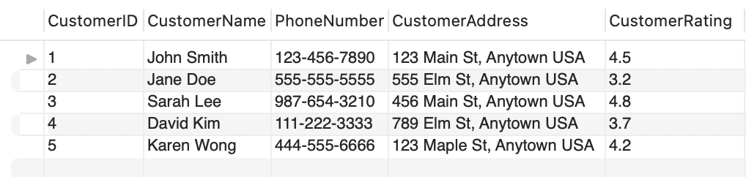
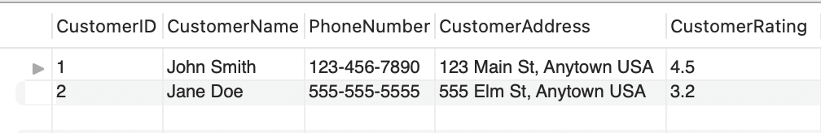
Example Query 3: Issuing Discount Codes
If a customer has made 2+ orders
If a customer has paid over $20 with Paypal
Notes:
> SELECT Customer.*
FROM Customer JOIN `order`
WHERE Customer.CustomerID = `order`.CustomerID
GROUP BY Customer.CustomerID
HAVING COUNT(`order`.OrderID) > 2;
> SELECT DISTINCT Customer.*
FROM Customer JOIN `order` JOIN Payment
WHERE Customer.CustomerID = `order`.CustomerID AND `order`.PaymentID = Payment.PaymentID AND Payment.PaymentAmount >= 20.00 AND Payment.PaymentType = 'PayPal';

Slide 23
Thank you!
Questions?

